Slide 1

Market-maximizing store location with multi-stop consumer trips
PRIMER SEMINARIO DE INVESTIGACIÓN DIE-UC 2019
Vladimir Marianov – PUC
H.A. Eiselt – UNB
Armin Lüer-Villagra – UNAB
1

Slide 2
Location problems with games
(why BK and KFC agglomerate)
PRIMER SEMINARIO DE INVESTIGACIÓN DIE-UC 2019
2

Slide 3
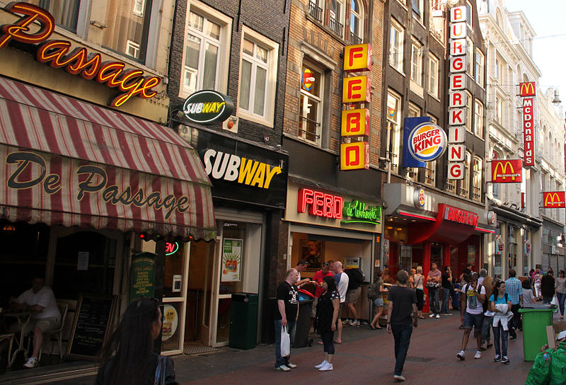
3

Slide 4
Overview
Introduction
Multipurpose shopping
Comparison shopping
Extensions

Slide 5
Introduction
We address location problems:
  Where, when, how many, how large, allocate
In particular, commercial stores
  Interaction of infrastructure and human behavior: several actors (firms, customers)
  Non competitive and competitive

Slide 6
A simple case. Discrete space. Single purpose trips
N_{i} = {j | d_{ij} < S}
v_{i} = 1 if customers at i travel
y_{j} = 1 if a store is located at j
S
S

Slide 7
Multipurpose trips. Games and Players
Firm 1, locates stores first
Firm 2, locates stores later
Consumers, choose what, where to buy, maximize utility
von Stackelberg games, sequential moves
Different cases

Slide 8
Game 1: Multipurpose shopping
Firm 1 sells pants, firm 2 sells shirts, both maximize their market. No “hard” competition
Consumers, choose what, where to buy: firms need to consider them
But
  no location literature on multipurpose shopping trips
  Economy, transport and marketing nerds have studied this
  2/3 of trips are multipurpose

Slide 9
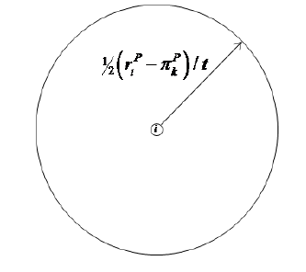
Consumer utilities
Single Stop Trip (SST)
Two Stop Trip (TST)
Store
A
Store
B
Consumer
i

Slide 10
Then
Firms must locate considering consumer behavior
Consumers choose highest utility trip: single, multipurpose
Game. Bilevel. B is follower
Max (Capture by B in SST’s + TST’s)
s.t. B locates n_{B} stores
Max (customers’ utility in SST’s or TST’s)
s.t. Each customer chooses one type of trip, or not purchasing at all

Slide 11
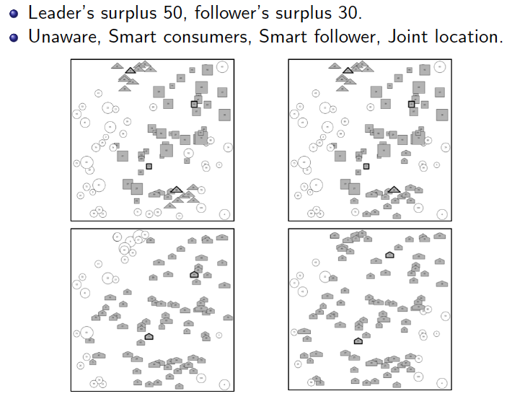

Slide 12
Game 2: Comparison shopping
Firm 1 and 2 sell different brands of shirts, both maximize their market. They compete: leader, follower
Consumers, choose what, where to buy
Consumers
  Taste uncertainty. Incomplete information on features, prices known.
  Consumers at i have a reservation price r_{i}
  Can visit one or two stores, purchase at most one unit. Depends on consumer’s utility
  Ceteris paribus, a 50% is purchased at each firm

Slide 13
Consumer utilities
Single Stop Trip (SST)
2 Stop Trip (TST)
There is an additional benefit u_{i2} for comparing
Several possible consumer search strategies
Store
A
Store
B
Consumer
i

Slide 14
von Stackelberg problem
Max (Capture by 2 in SST’s + TST’s)
s.t. 2 locates n₂ stores
Max (customers’ utility in SST’s or TST’s)
s.t. Each customer chooses one type of trip, or not purchasing at all

Slide 15
We formulate it as one level
Max (Capture by 1 in SST’s + TST21’s + TST12’s)
s.t. - 1 locates n₁ stores
- “highest utility constraints” (one for each possible mode: SST 1; SST 2; SST tie; TST21; TST12)
- At most one purchase is made, one mode

Slide 16
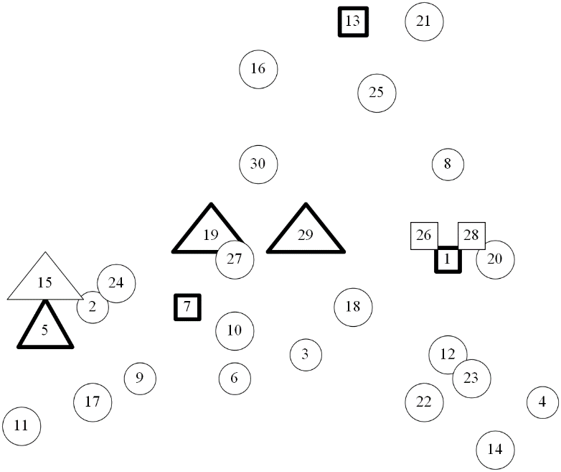
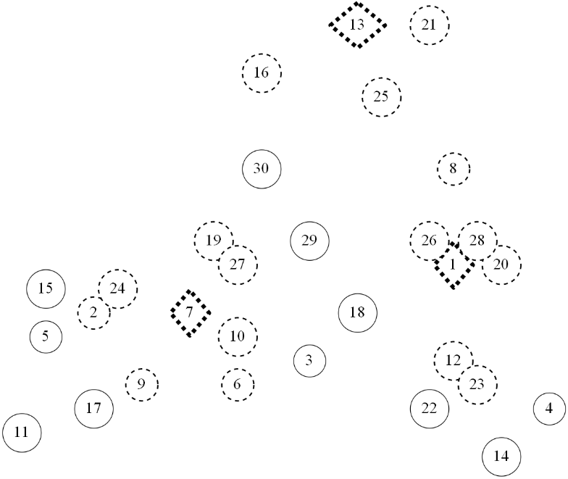


Numbers and locations, r = 50
Leader locates MCLP; u_{i2} = 0, 100, 200, 300

Slide 17
Extensions
Different customer behaviors
Discrete choice models
Leader problem
Several stores
Webrooming, Showrooming, general effects of internet on locations

